Slide 1
E-WOMEN
Divya Jyoti Sharma-1206810083
Jishnu Vasan-1206810098

Slide 2
Problem Statement
In today's scenario the women are educated enough to use smart phones and computers but still many of them willingly or unwillingly are housewives or due to other reasons have unfulfilled business dreams. Some of the initial basic problems are :-
Some working women have a lot of free time (weekends, vacations) which they may want to utilize but there is no platform to help them.
Some become helpless due to some misfortune example divorce, family problems, widowed and were previously dependent of their counterpart.
Also there are many women who are housewives and cannot go out and work, though they want to work from home at both skilled and unskilled level.
Many women who can be potential entrepreneurs are mostly confused on how to startup a business and where it is apt to invest.
Many women do have a dream and a business idea but lack motivation and the financial help.

Slide 3
Required Functions of project
Functions of Women Entrepreneurs : A Woman entrepreneur has also to perform all the functions involved in establishing an enterprise
Functions for establishment of an enterprise
Idea generation and screening
Determination of objectives
Undertaking a risk and handling of economic uncertainties involved in business.
project preparation
Product analysis
Introduction of innovations, imitations of innovations.
Form of business
Co-ordination, administration and control.
Raising funds
Supervision and leadership.
Procuring men, machine and materials and operations of business.

Slide 4
Product Functions
A. Home Job Board
It has two subsections post job and available jobs.
Post job – In this section the registered members can post a job they desire to get work done. All they have to do is to fill a form providing the title,description,amount,duration,to be more specific they can post.
Available Job – In this subsection the other members who are looking for a home job can see the current available job and book their interest accordingly.
Already booked job are removed.
Jobs can be search by near by location with the help of map.
Anyone can sign up to use this facility.
Email can be send to the chosen applied candidate.

Slide 5
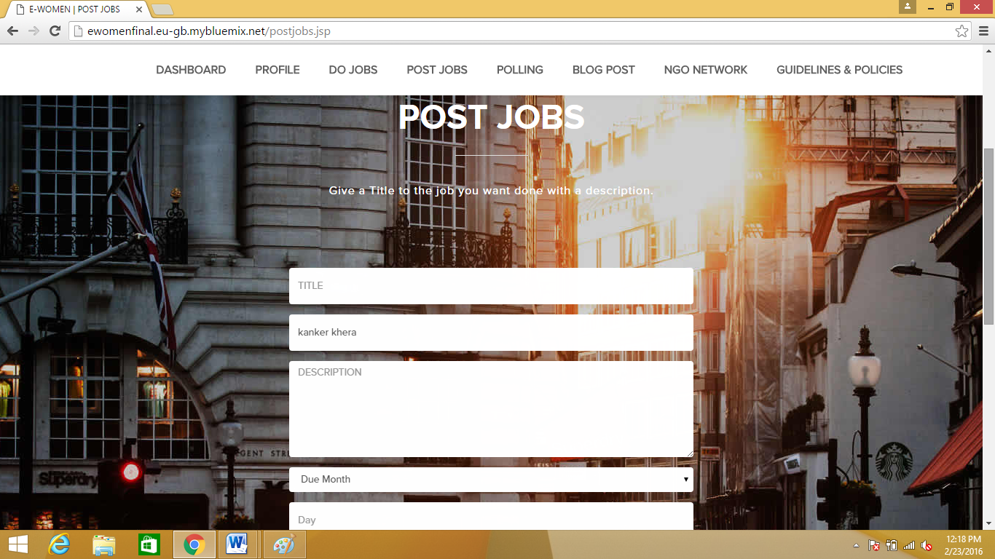
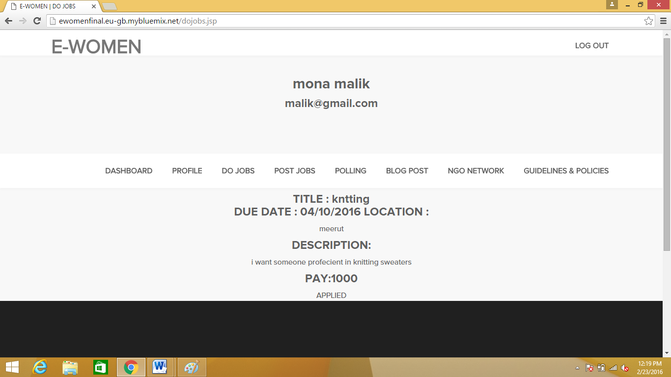

Slide 6
B.Polling Forum
In this anyone can post a problem/Poll in case of a problem or doubt.
Maximum 6 options can be provided.
Other registered members can vote.
Comments facility is also provided.
Final result will be provided on the basis of all votes.
Any one can sign up to use this facility

Slide 7
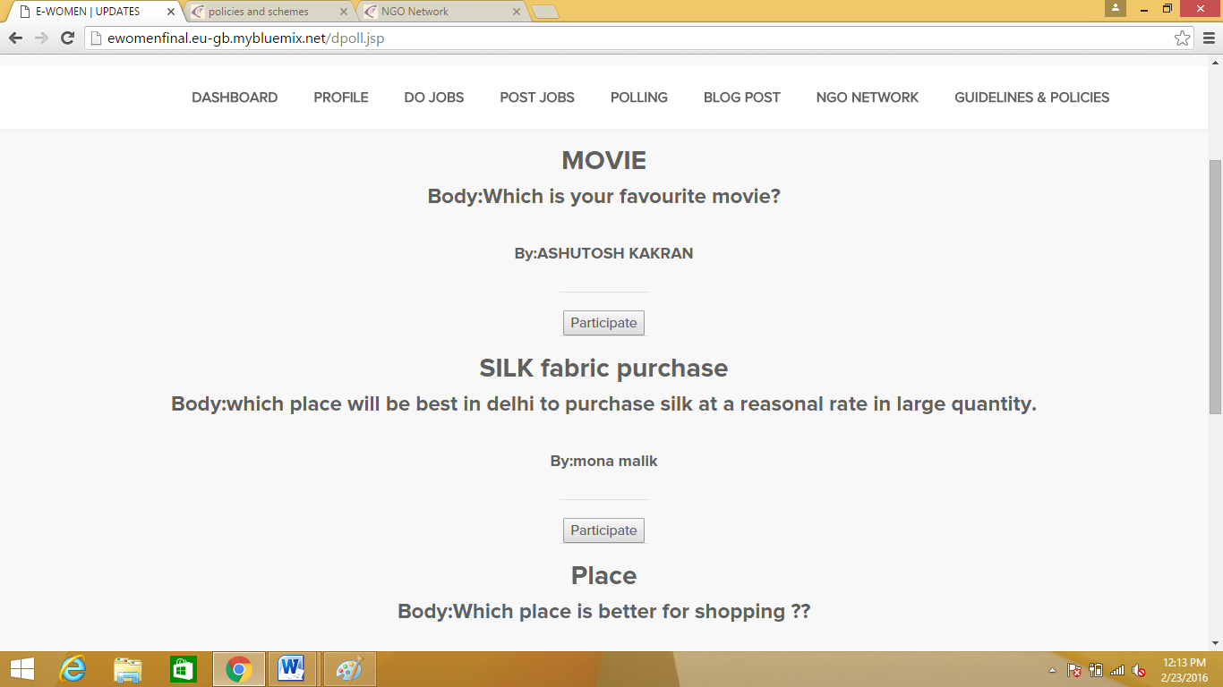
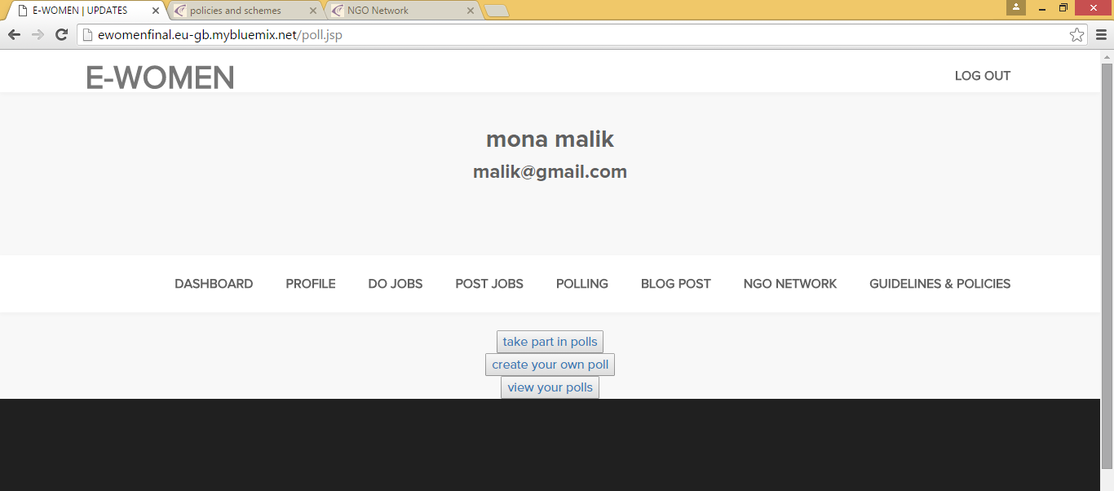

Slide 8
C. Business NGO Network
Information of business NGO are provided.
Proper details of NGO are provided.
NGO location can be track in map.
Non registered members can access these too.

Slide 9
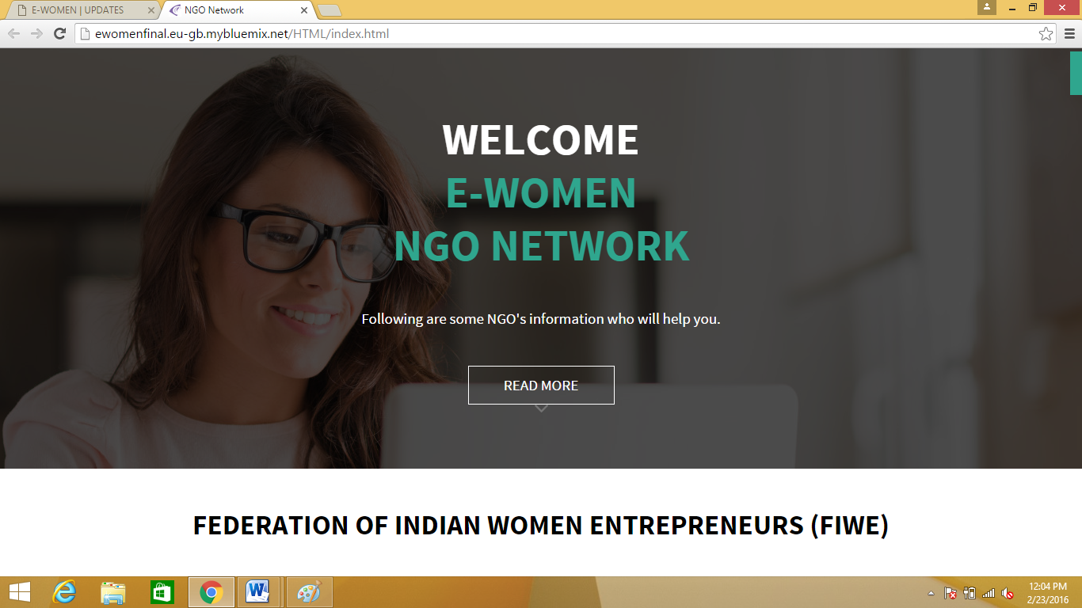
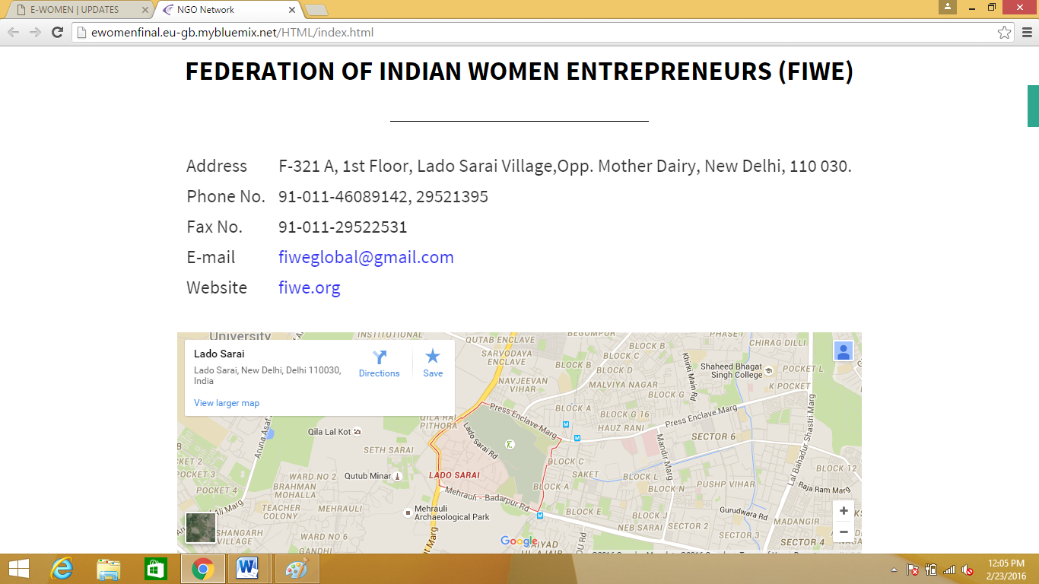

Slide 10
D. Business Loan and Policies
Provide information of current women business loans.
Provide special policies and schemes going on business for women.
Provide detail of schemes of all types of business(food,parlour,fashionetc).
Non registered members can access these details too.

Slide 11
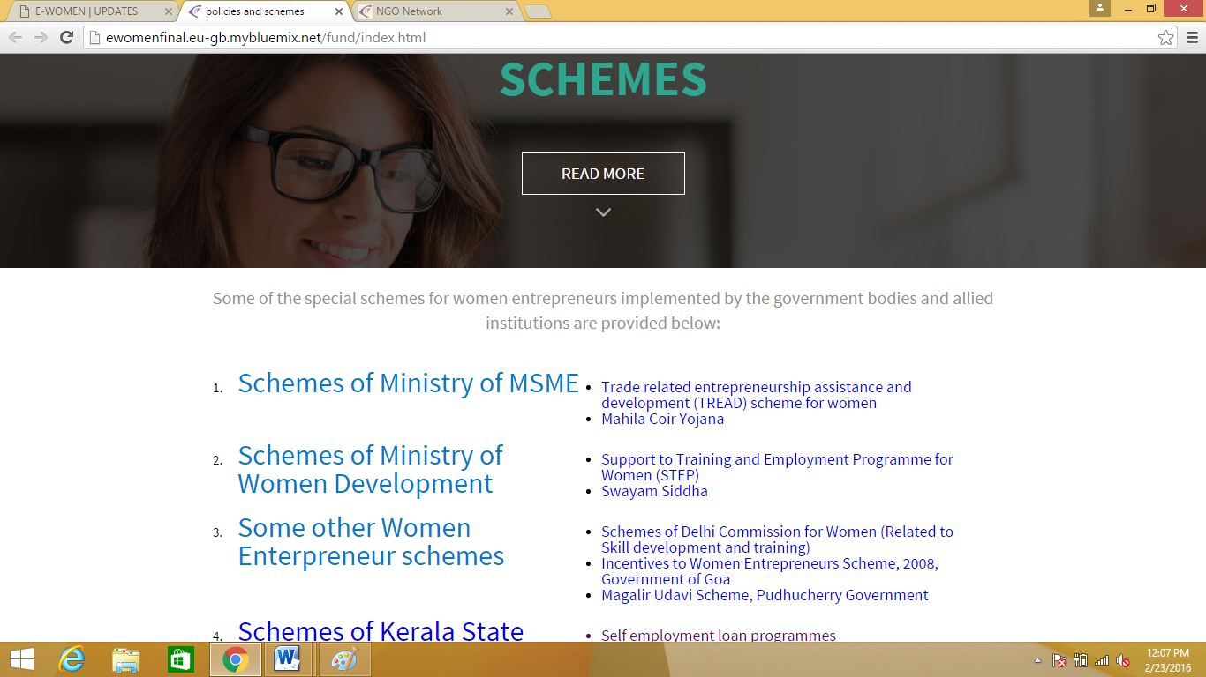
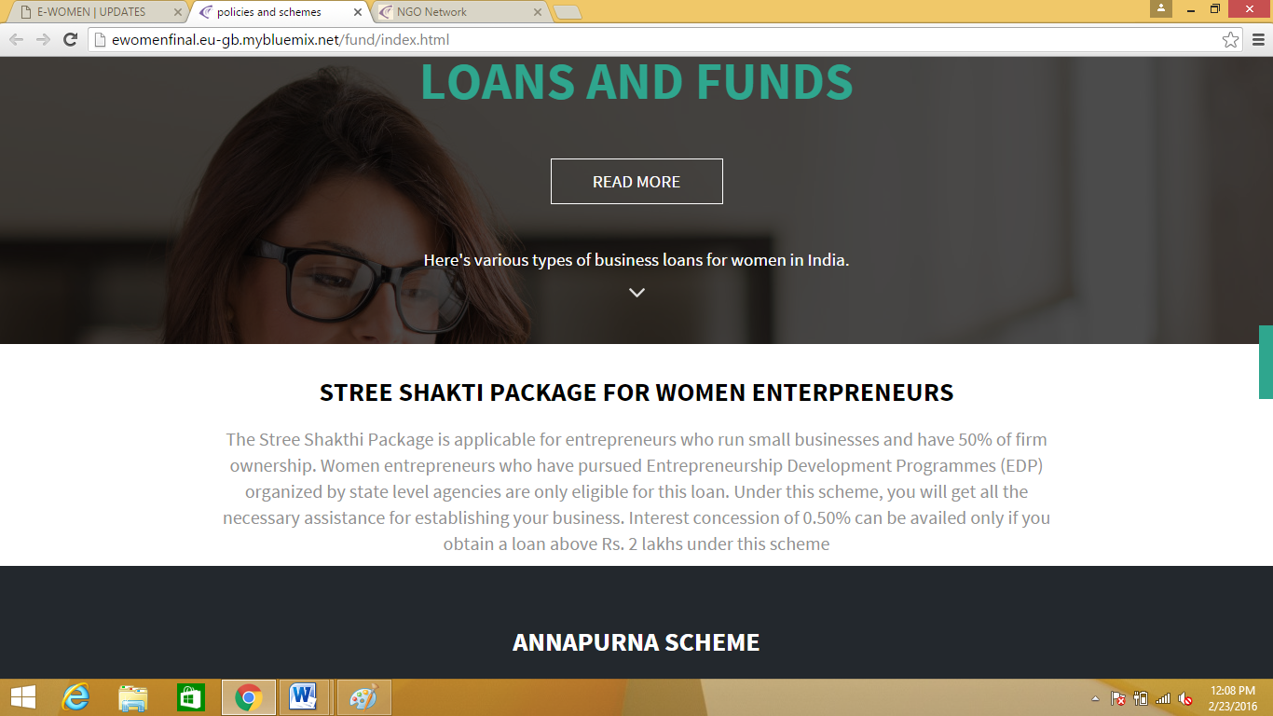

Slide 12
E.Buiness Guidelines
Provide startup business work plan and guidelines.
Information require to start a business expected help.
Cover all the official step in sequence to startup a business.
Cover all legal regulations and aspects.
Non registered member can access these details too.

Slide 14
F. Blog Post
In this members can post new business ongoing trend or ideas.
Their experience to ignite other women.
Registerd members can see these post.
Registered members have the facility on comment on these post.

Slide 15
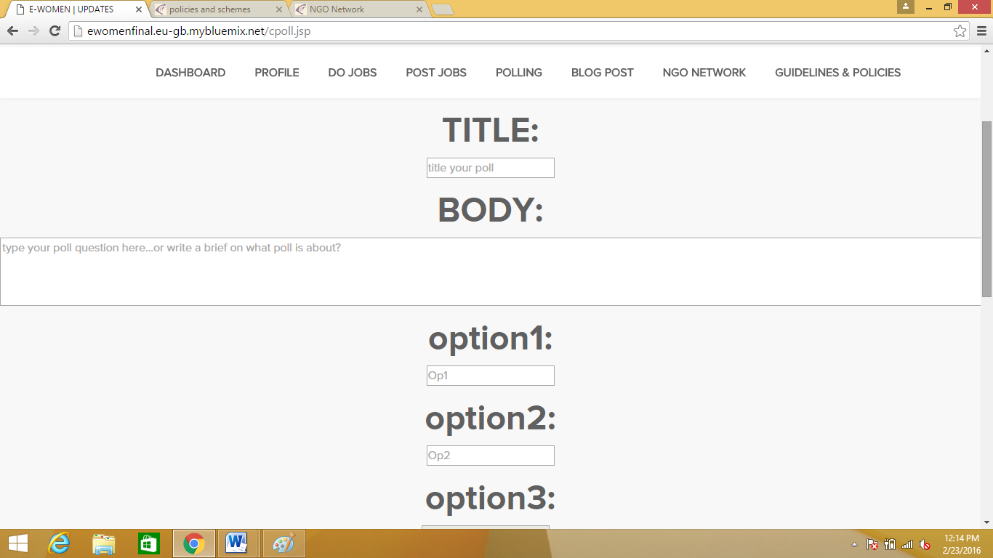
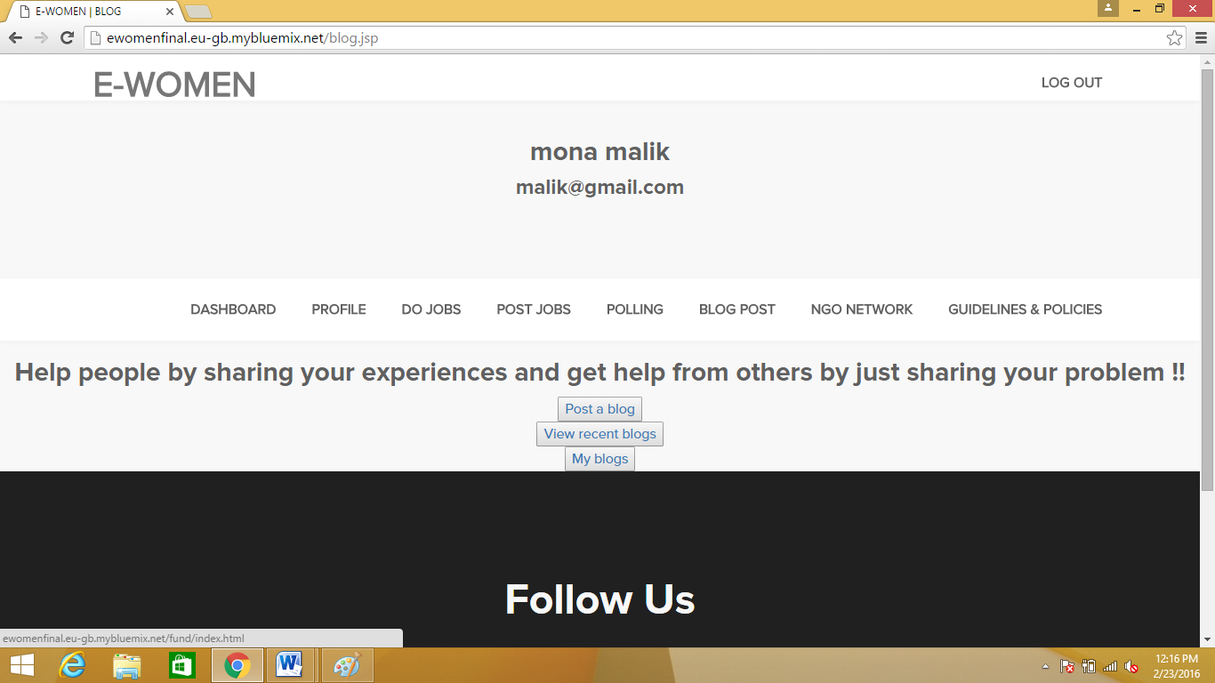

Slide 16
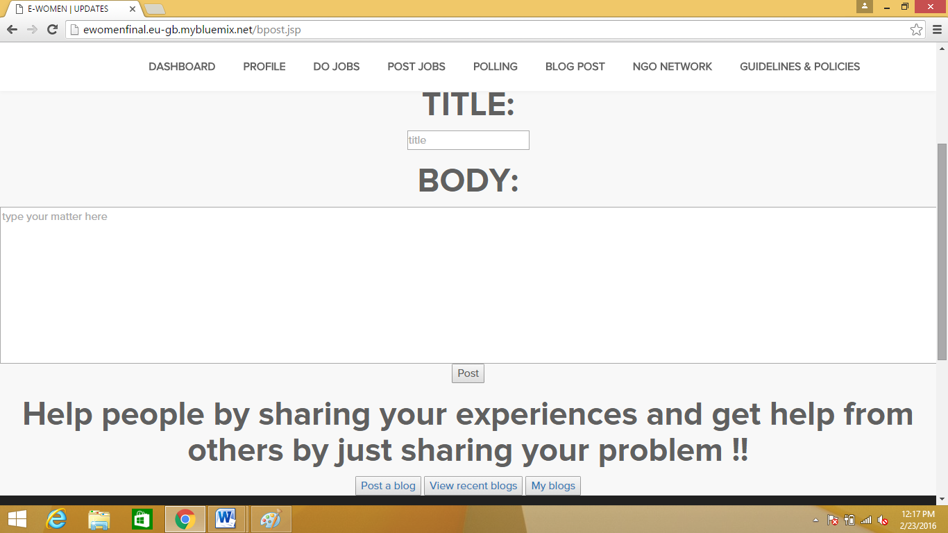
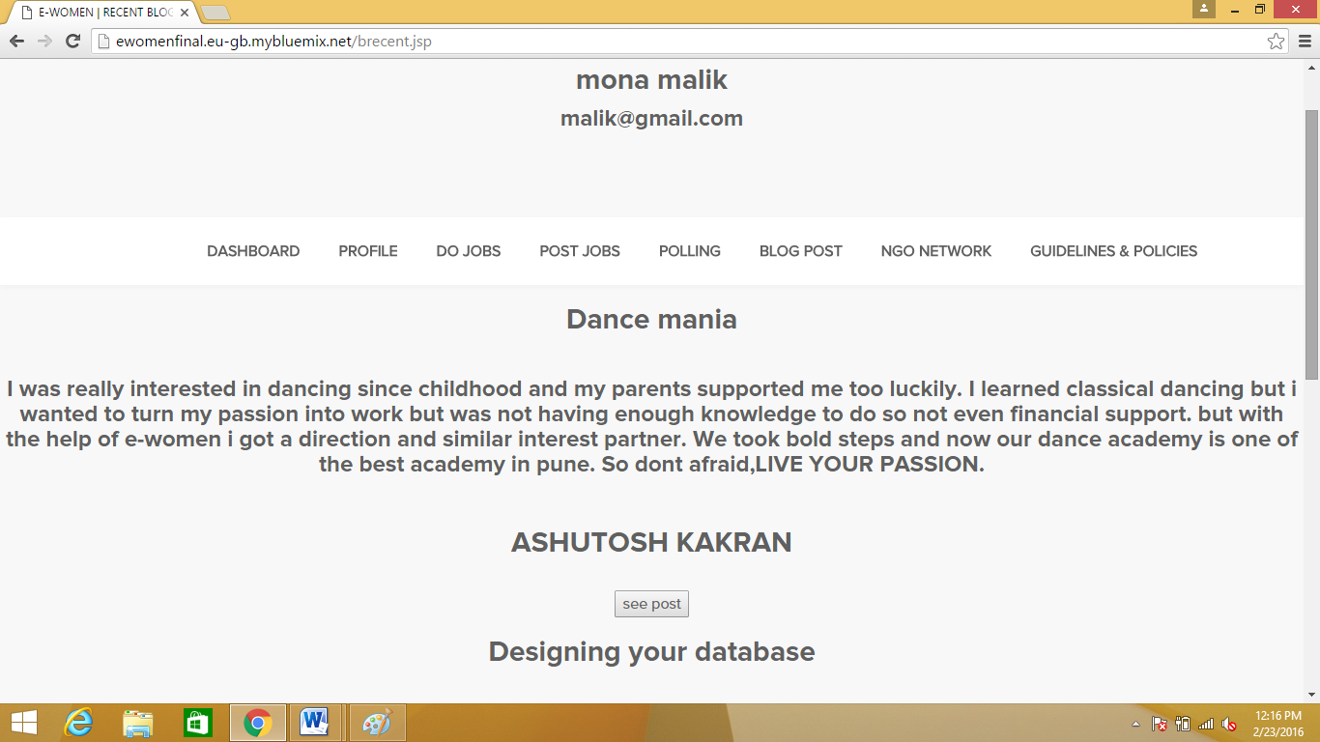

Slide 17
G. Admin Panel
Interface for admin of the site to check site usage.
Interface to view user activity in form of excel sheets( specifically .xls).
Interface to allow admin to delete annoying users,posts,blogs and Polls.
An Interface to view and respond emails from users who want to contact the website.

Slide 18
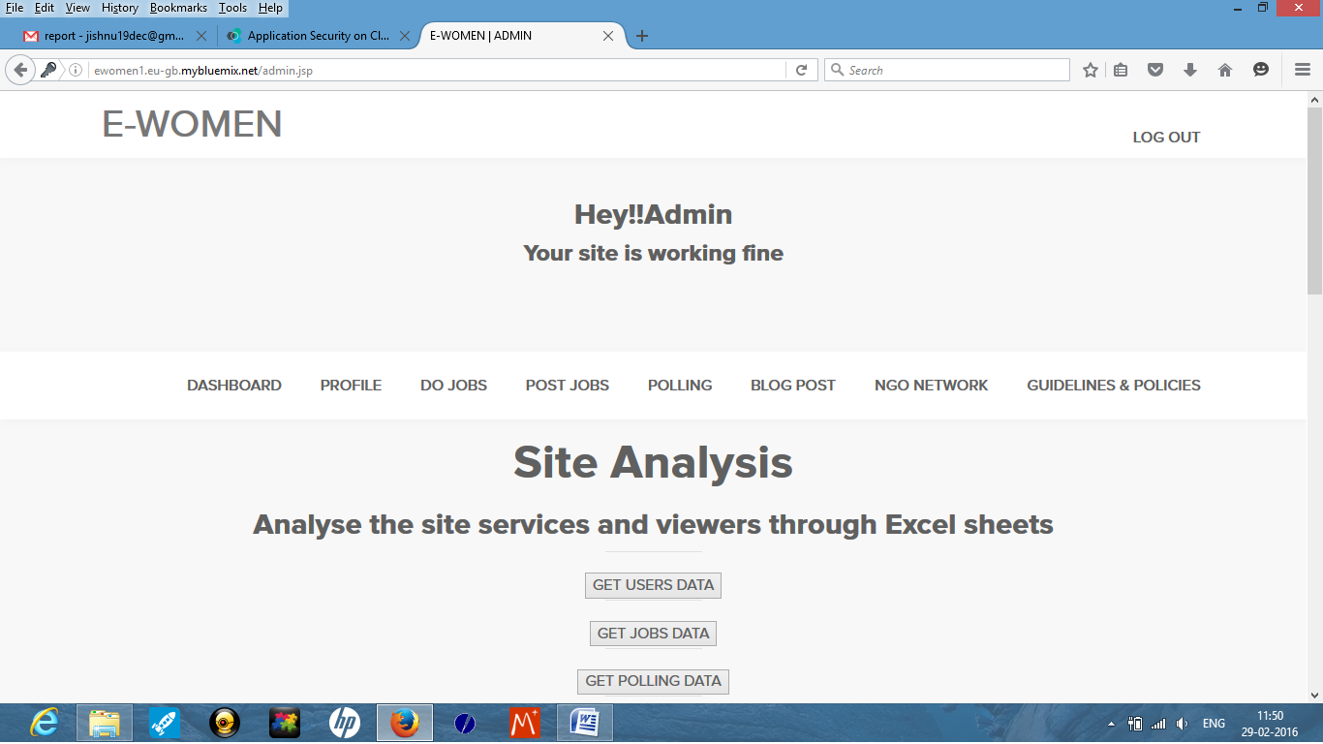
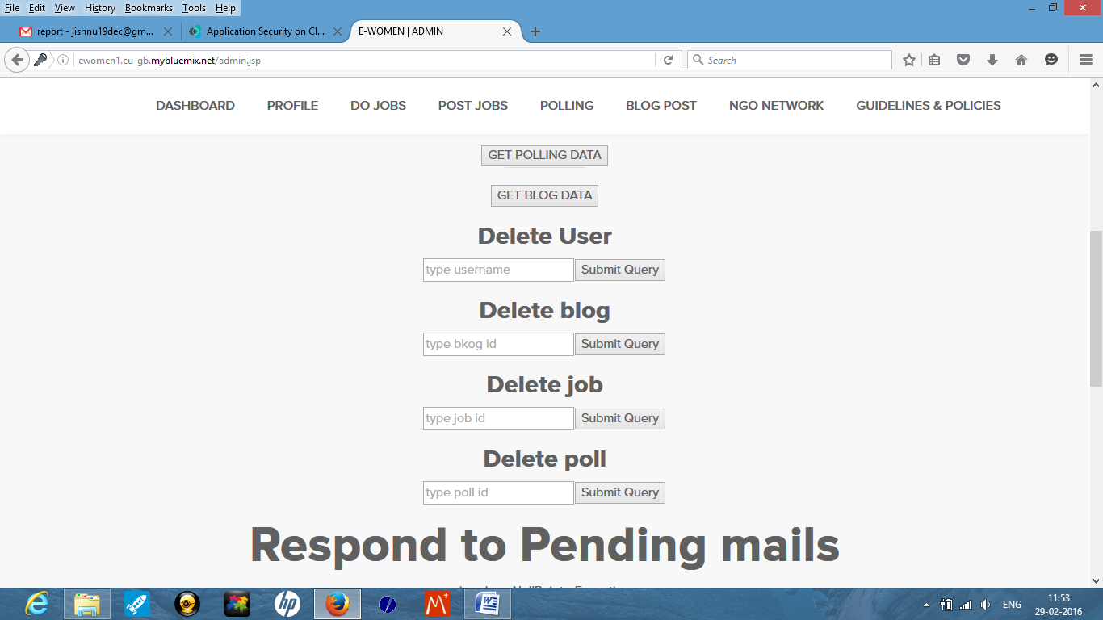

Slide 19
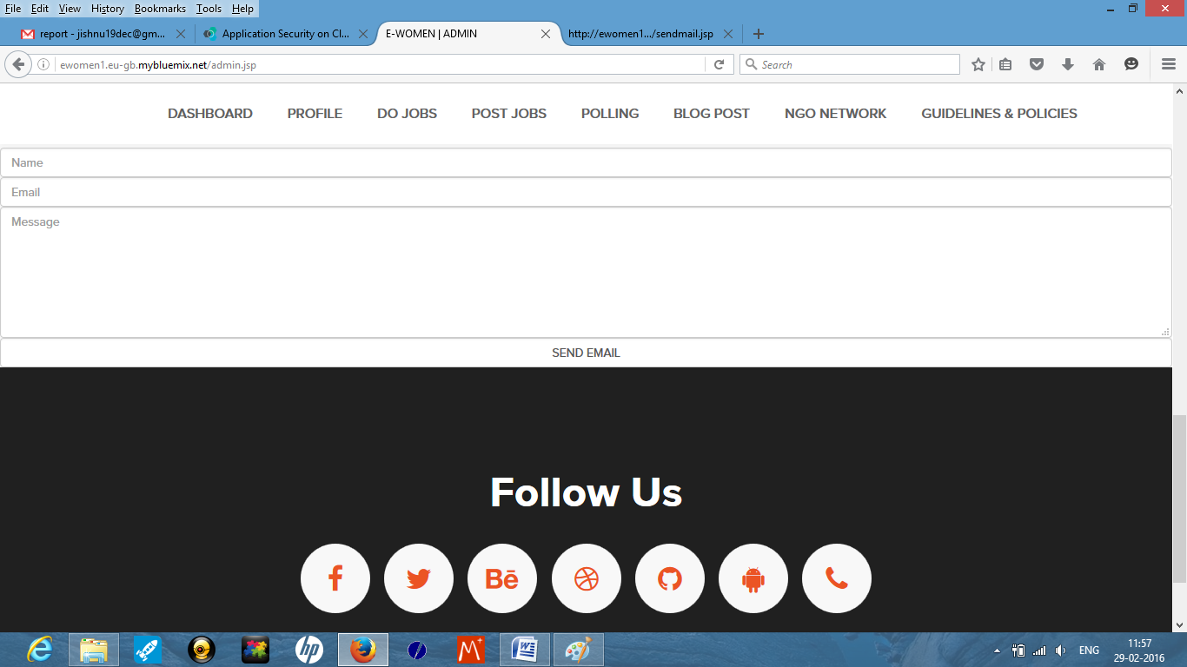

Slide 20

Home Page

Slide 21
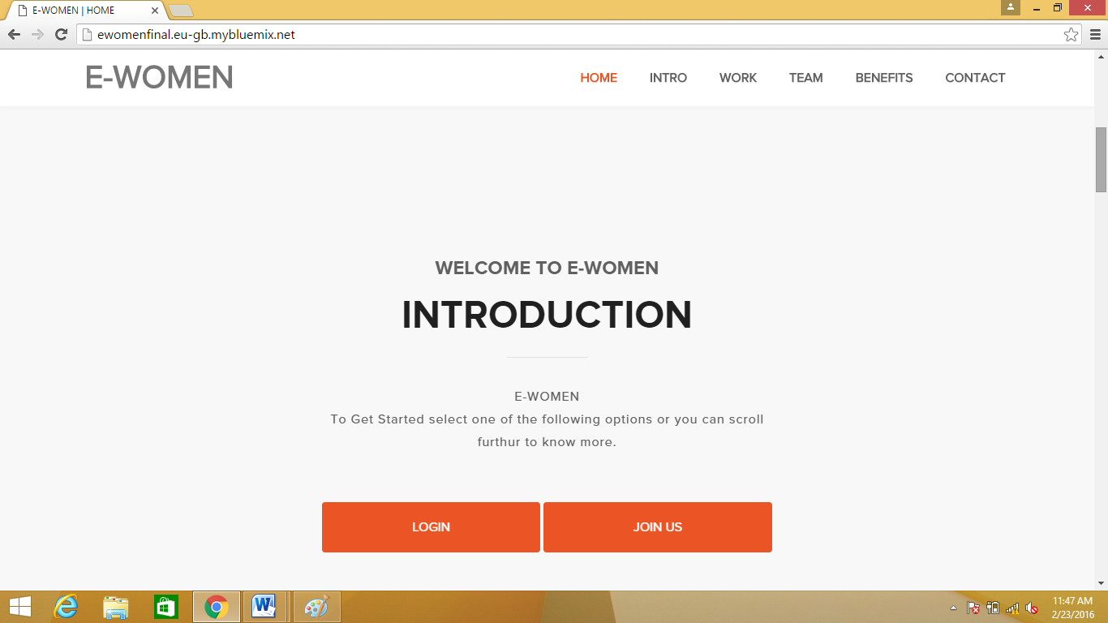

Slide 22
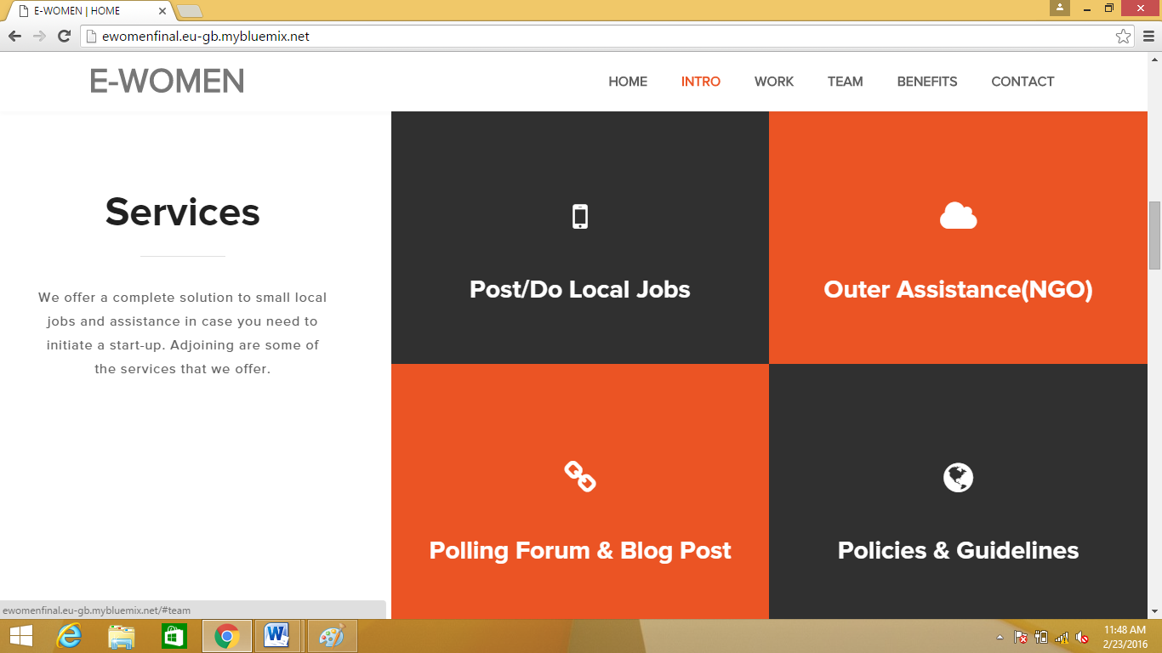

Slide 23
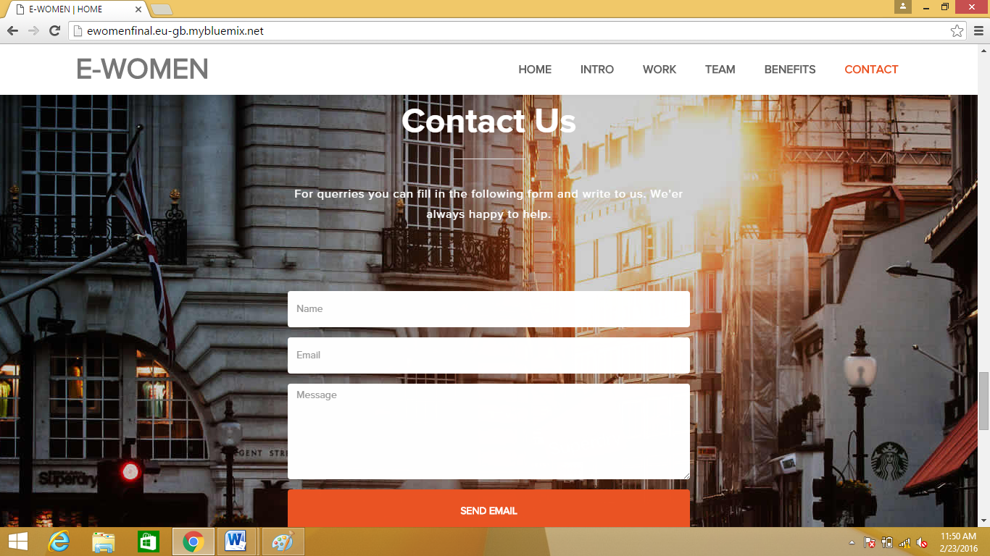

Slide 24
REFERENCES
http://www.womenentrepreneursontheweb.com/
http://femaleentrepreneurassociation.com/
https://www.themuse.com/advice
Entrepreneurship Development –By S.S Khanka. S. Chand& Company Limited.
A Reflection of the Indian Women in Entrepreneurial World www.iimahd.ernet.in/publications/data/2005-08-07indirap.pdf
www.indianmba.com/Faculty_Column/FC1073/fc1073.html
www.oppapers.com › Business & Economy Research Papers
www.asiaentrepreneurshipjournal.com/AJESVolIIIss1Malar.pdf
www.academicjournals.org/ajbm/.../Witbooi%20and%20Ukpere.pdfWOMEN

